Slide 1
Application of Geoinformatics technology for Mapping Air Pollution

Slide 2
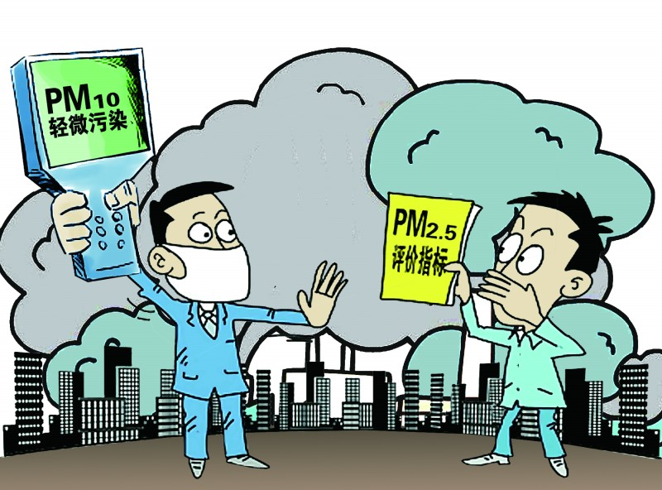
Air Pollution

Slide 3
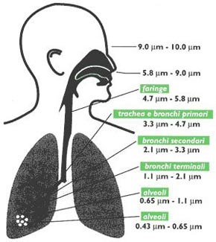
Impact on the body

Slide 4
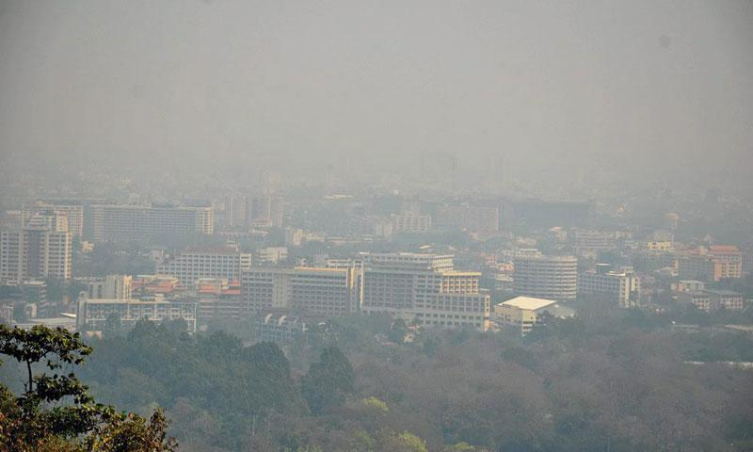
The general atmosphere

Slide 5
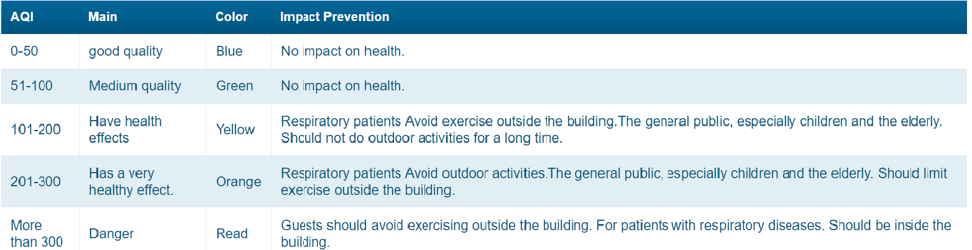
Table standard dust

Slide 6
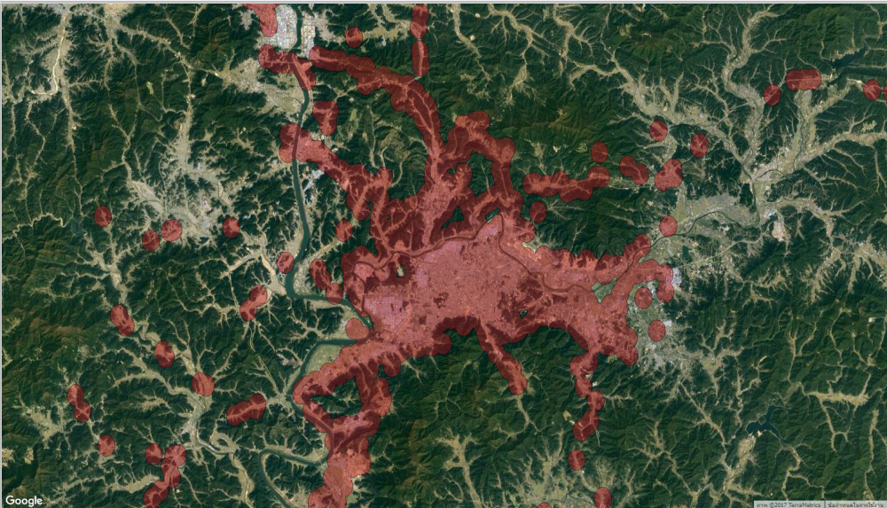
Objectives
1. To visualize air pollution level
2 .To analyze the risk area that could affect public health

Slide 7
Methodology
1.Create houses/parcel map using Google Earth Pro.
2.Import data into PostGIS database management software.
3.Visualize air pollution levels in QGIS software
4.Analyze air pollution using spatial operations, such as union and intersection.
5.Intersect the result with the parcel map to find the risk areas.

Slide 8
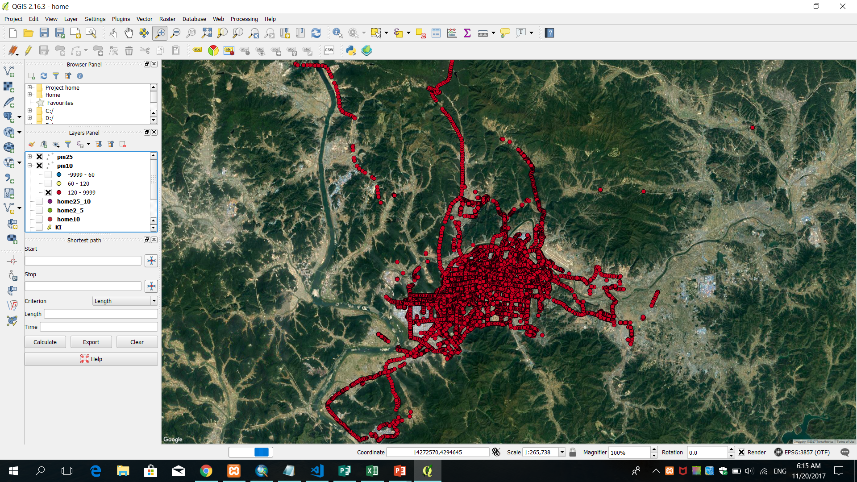
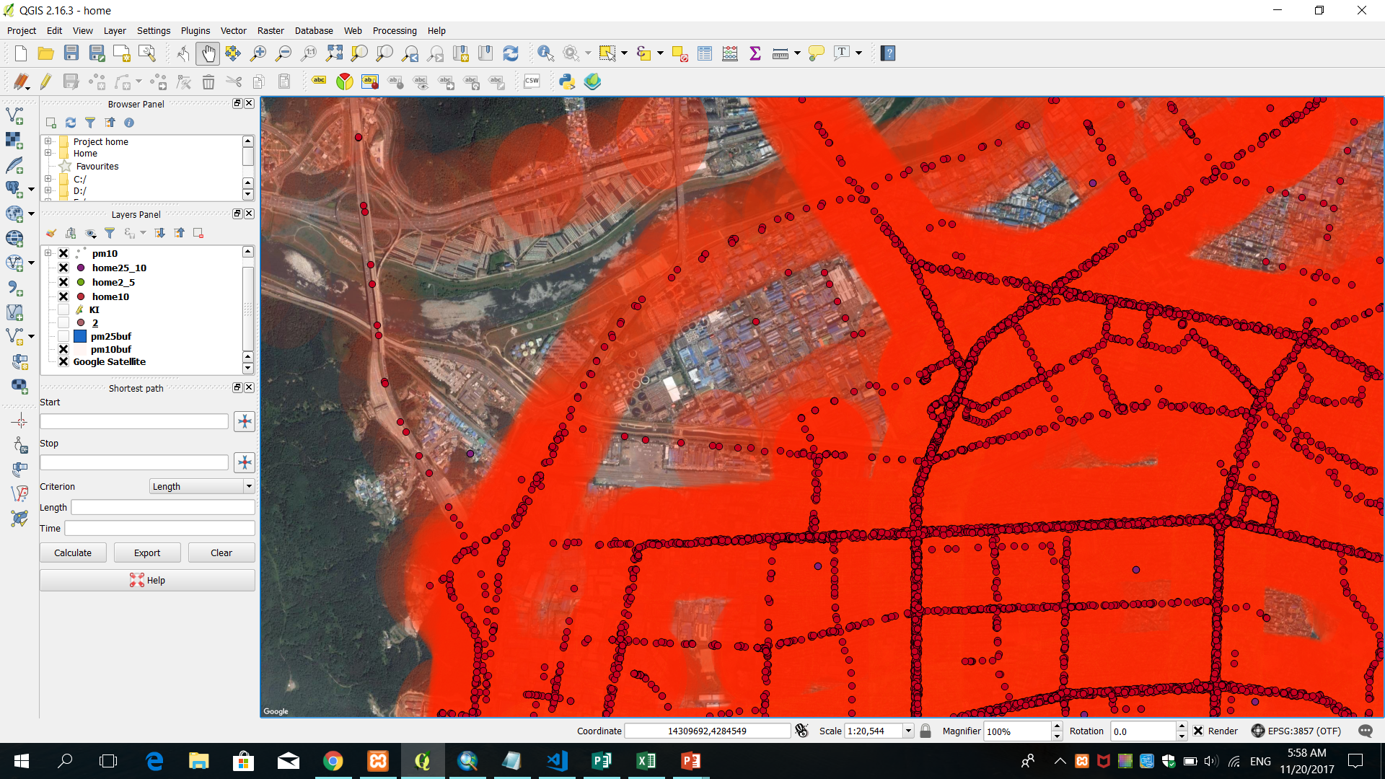
result

Slide 9
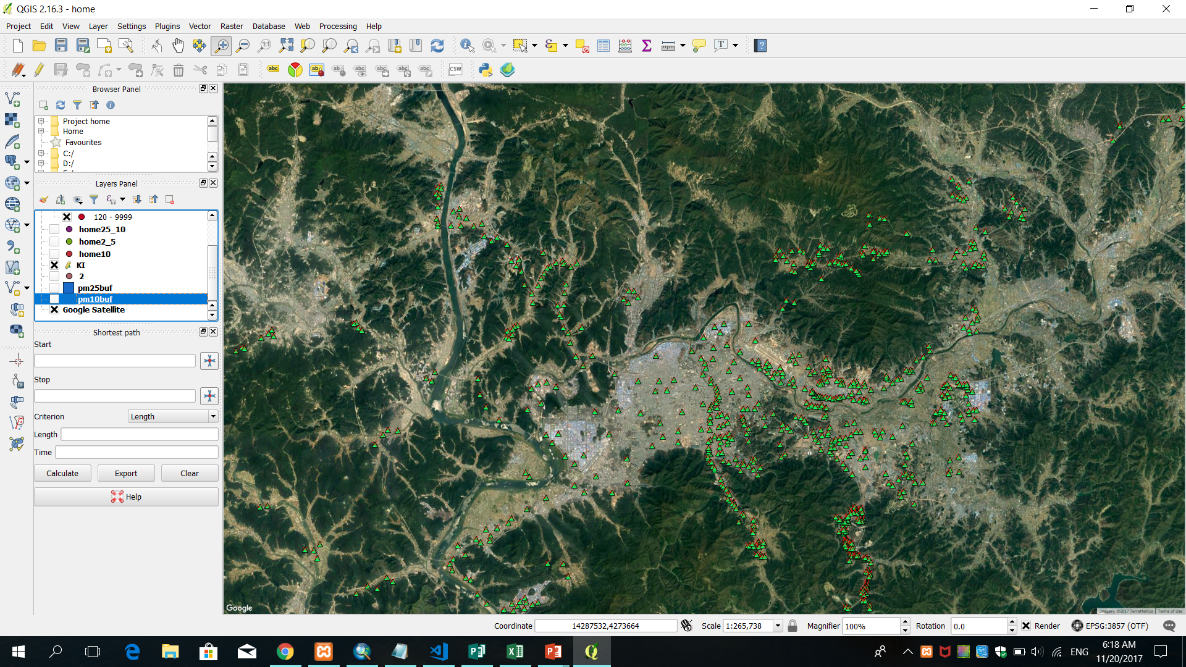
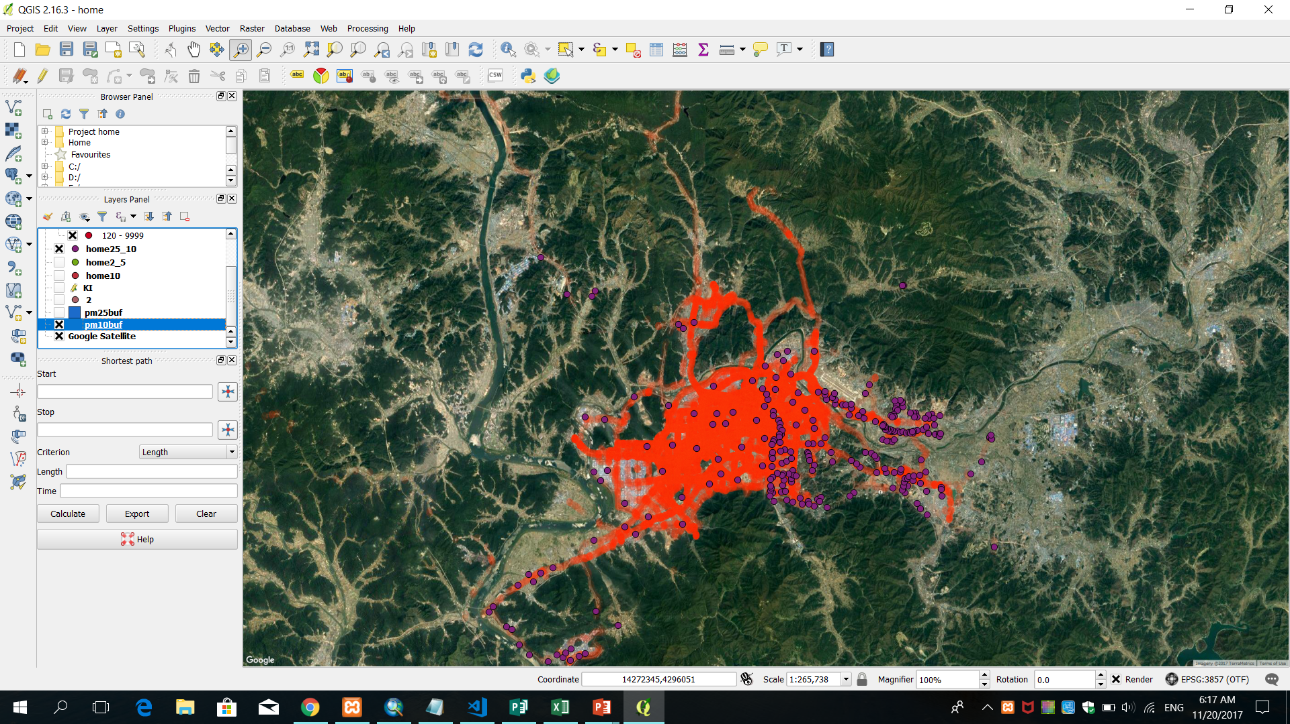

Slide 10
THE END THANK YOU

